Slide 1


Facial recognition using LBPH Algorithm -for Digital payments
Dept.of ECE
GITAM School of Technology
GITAM ,Bangaluru-561203
(DEEMED TO BE UNIVERSITY)
322010403006 Kodidela Dinesh Naidu
322010403031 Boksam Nithin Varma
322010402033 Mange Amith Das Guided By: 322010402004 R.Nikhil Kumar DR Ramesha M

Slide 2
Abstract
The digital payment systems are evolving rapidly from past few decades by
overcoming the problems that were existing in the previous payments system. In this paper, we proposed the system for digital payments by using the facial recognition. By using this proposed system it is possible to make the payments without using any cards or cash or mobile hence even if customer forgot his wallet or mobile the payments system will be uncompromised. In this paper LBPH is used for facial recognition as LBPH algorithm can be used to represent local features in the images. Good results can be obtained using LBPH algorithms primarily in a managed environment.

Slide 3
Literature Survey:
Ref No:- | Title of Paper | Abstract | Outcome | Methodology | Research gap
1 | Development of integrated mobile money system using Near Field Communication (NFC)-E. Husni and A. Ariono | Developed an electronic payments system using Near Field Communication (NFC) enabled android smartphone transactions. Transaction data was composed of encrypted payloads, header, and initialization vector used to decrypt the payload | This paper demonstrates that the proposed system can provide a secure and convenient mobile money service using NFC technology. The paper also shows that the system can prevent various attacks such as eavesdropping, data modification, replay, and relay attacks. The paper reports that the system can achieve an average transaction time of 4.2 seconds and a user satisfaction rate of 86%. | The paper demonstrates the system using a prototype application installed on two NFC-enabled Android smartphones | The paper identifies a research gap in the existing mobile money systems that do not use NFC technology or use it in a limited way. The paper argues that NFC technology can offer several advantages such as easy pairing, fast data transfer, low power consumption, and high security.

Slide 4
Ref No:- | Title of paper | Abstract | Outcome | Methodology | Research gap
2 | A Digital Token System for Secure and Private Transactions Based on Cryptography--Rajendran et al. 2017 | Transactions between payers and payees often involve risks such as identity theft, fraud, and counterfeiting. This paper proposes a digital token system that uses cryptography to protect the security and privacy of the transactions | The paper shows that the proposed system can provide secure and private transactions using digital tokens | The paper designs the system using cryptographic algorithms and protocols, The paper analyzes the system using mathematical models and simulations, The paper compares the system with existing payment systems in terms of security, privacy, convenience, and scalability. | The paper argues that cryptography can provide a solution to these issues by using digital tokens that are encrypted and signed. The paper also claims that cryptography can enhance the convenience of the transactions by enabling pseudo identities and device independence.
3 | A Biometric Face Recognition Payment System Using Image Normalization and Eigenfaces--Surekha. R. Gondkar, Saurab. B, C. S. Mala | Face recognition is a biometric technique that can be used for digital payments without the need of cards or cash. However, face recognition faces challenges such as variations in lighting, pose, and expression. This paper proposes a face recognition payment system that uses image normalization and eigenfaces to overcome these challenges | The proposed system can provide a convenient and secure face recognition payment service. The paper also shows that the system can achieve high accuracy, fast speed, and positive user feedback. The paper reports that the system can recognize 95% of the faces correctly, process each transaction within 5 seconds, and receive a user satisfaction rate of 88% | This paper follows a design and evaluation approach to develop and test | The paper identifies a research gap in the existing face recognition payment systems that do not use image normalization or eigenfaces. The paper argues that image normalization can improve the quality and consistency of the face images.

Slide 5
Ref No:- | Title of Paper | Abstract | Outcome | Methodology | Research gap
4 | Face Spoof Detection on Smartphones Using Image Distortion Analysis---K. Patel, H. Han and A. K. Jain | Face spoof attacks are a serious threat to face recognition systems, especially on smartphones that are used for unlocking and mobile payment. In this paper, we propose a novel method for face spoof detection on smartphones using image distortion analysis. We first normalize the face images based on the inter-papillary distance and extract the red color channel for feature extraction | The proposed method achieves state-of-the-art performance in face spoof detection on smartphones, with an average accuracy of 98.6% on the CASIA-FASD dataset and an average accuracy of 97.4% on the Replay-Attack dataset. | Face normalization Feature extraction Image quality metrics Bezel detection | The existing methods for face spoof detection on smartphones either rely on additional hardware (such as depth sensors or infrared cameras) or have limited generalization ability across different datasets and attack scenarios. The proposed method addresses these limitations by using only image distortion analysis and bezel detection, which are robust and effective against various types of spoof attacks.
5 | A Model to Enhance Security Of Digital Transaction -S. Nair, S. K. Khatri and H. Gupta | Nair et al. (2019) presented a resilient three-factor authentication approach for safeguarding UPI mobile wallet transactions. The protocol integrates password, certificate, and biometric/Time-based One Time Password (TOTP) to counter session capture attacks, ensuring transaction security | The proposed authentication protocol enhances the security of digital transactions within UPI mobile wallets by effectively thwarting session capture attacks. | Combination of password, certificate, and biometric/Time-based One Time Password (TOTP), Integration of three factors to establish robust authentication, Focus on countering session capture attack | The study contributes to addressing the security vulnerabilities associated with digital transactions in UPI mobile wallets. It emphasizes the need for improved authentication methods to protect against session capture attacks.

Slide 6
Ref No:- | Title of Paper | Abstract | Outcome | Methodology | Research gap
6 | LBPH Based Improved Face Recognition at Low Resolution--Ahmed, J. Guo, F. Ali, F. Deeba and A. Ahmed | we propose a system for face recognition using the Local Binary Patterns Histogram (LBPH) algorithm, which is a robust and efficient method for face representation and feature extraction. | The proposed system achieves 97.6% accuracy on the LR500 dataset, which is higher than the existing methods such as Eigenfaces, Fisherfaces, and LDA. The proposed system also has a fast processing speed of 0.2 seconds per image, which is suitable for real-time applications. | Face detection Face representation Face recognition | The existing methods for face recognition at low resolution either suffer from low accuracy or high computational complexity. The proposed system addresses these limitations by using the LBPH algorithm, which is robust to noise, illumination, and pose variations, and has a low computational cost

Slide 7
Objectives
To design and implement a facial recognition system that uses Local Binary Patterns Histogram (LBPH) algorithm to extract and compare the features of the face images.
To evaluate the performance and accuracy of the LBPH algorithm in terms of recognition rate, false acceptance rate, false rejection rate, and processing time.
To enhance the security and privacy of the facial recognition system by using encryption, authentication, and verification techniques.
To provide a user-friendly and convenient interface for the customers and merchants to use the facial recognition system for digital payments.

Slide 8
Introduction to LBPH algorithm
LBPH (Local Binary Pattern Histogram) is a Face-Recognition algorithm
it is used to recognize the face of a person. It is known for its performance
and how it is able to recognize the face of a person from both front face and side face

Slide 9
IMPLEMENTATION OF LBPH ALGORITHM
This system takes the input and returns the face that matches with ID and
histogram value is calculated for this input using the Euclidean distance formula,
checks with matching histogram value at the trained dataset is checked and
provides the output along with the identification number, The only one that
requires is to keep the numbers remember to make the payment. The face is the
major thing in our system, it leads the entire process.

Slide 10
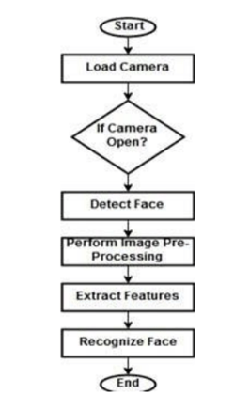
STEP 1:-
Work flow of a diagram
of a camera:

Slide 11
STEP 2 :-
FACE DETECTION
We have utilized OpenCV which presents a HAAR CASCADE CLASSIFIER,
which is utilized for face discovery. The Haar cascade classifier utilizes
the AdaBoost calculation to recognize different facial highlights, it
continues to inspect the face highlights and draw a rectangular
casing on the distinguished face

Slide 12
HAAR CASCADE CLASSIFIER:-
The algorithm can be explained in four stages:
Calculating Haar Features
Creating Integral Images
Using Adaboost
Implementing Cascading Classifiers

Slide 13
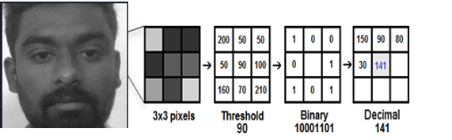
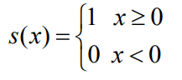
STEP 3 :-
FEATURE EXTRACTION
The LBP administrator is applied to depict the complexity data of a pixel to its
local pixels. The first LBP administrator is characterized in the window of 3*3.
Utilizing the middle pixel esteem as the edge of the window, it contrasts and the
dim estimation of the contiguous 8 pixels. On the off chance that the local pixel
esteem is bigger or equivalent contrast with the middle pixel esteem

Slide 14
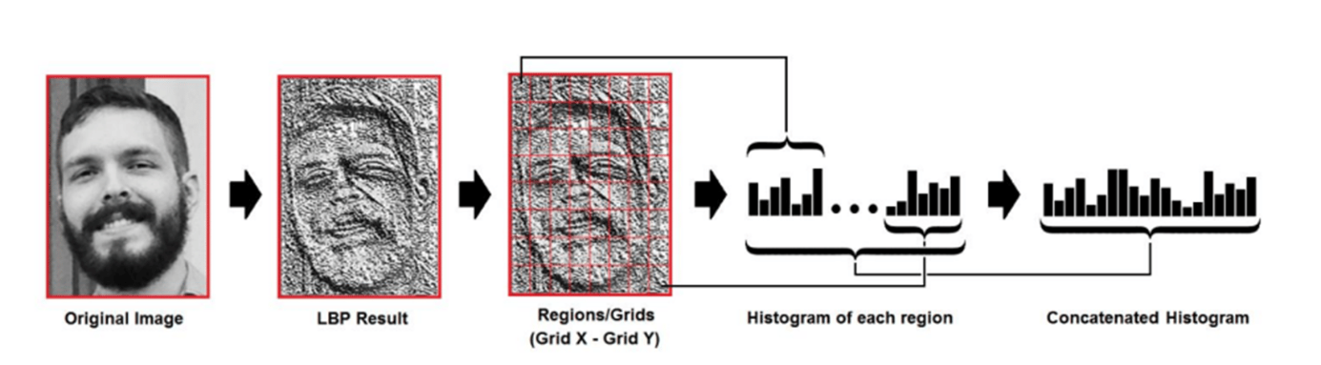
STEP 4 :-
CREATING HISTOGRAMS OF CAPTURED IMAGE
The histogram is nothing but the graphical representation. But here the histograms are
generated for each region of the pixel which is extracted feature from the input image.
The grid x and grid y the grayscale image is divided for that histogram is generated for each
region, at last the histograms created are concatenated so as to develop the huge graph for the
image. The histogram development how it happens

Slide 15
STEP 5:-
FACE RECOGNITION
To perform the face recognition, the algorithm should be already trained. The histogram each
used to represent each picture from the training data. So to discover the picture that
coordinates the information picture we simply need to look at two histograms and return the
picture with the nearest histogram. We can utilize different ways to deal with look at the
histogram

Slide 16
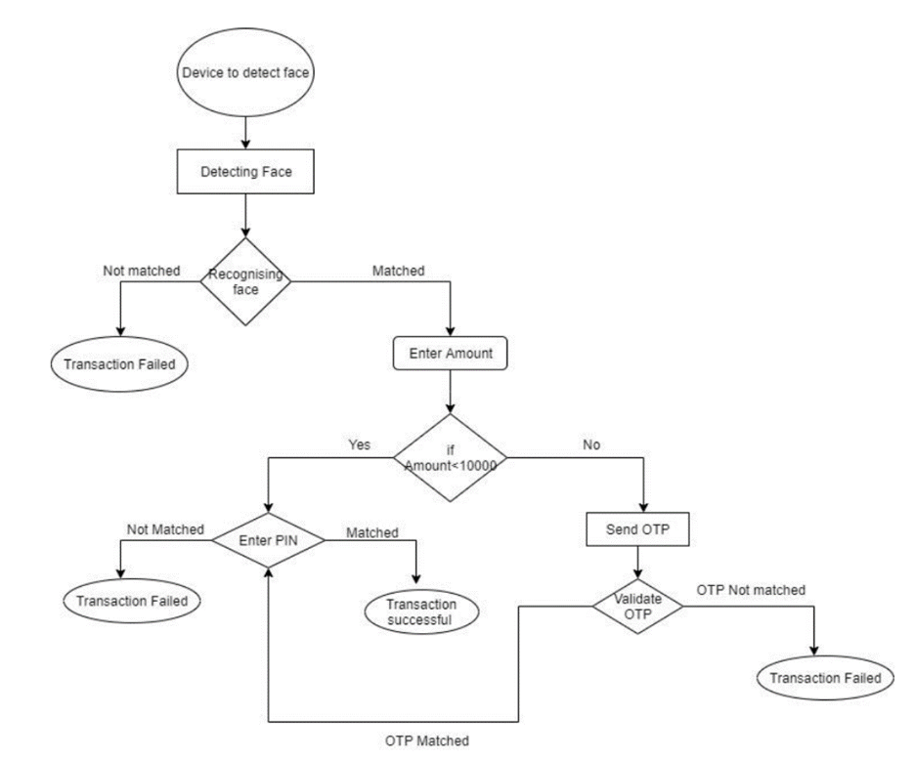
System Architecture

Slide 17
Software Requirments
OS : Windows or Linux
Python IDE
Softwares to be imported to program
Numpy
Opencv2
os
PIL(python imaging library)
PIP(preferred installer program)

Slide 18
Hardware Requirments
RAM : 4GB and Higher
Processor : Intel i3 and above
Hard Disk : 500GB (minimum)
Web Cam

Slide 19
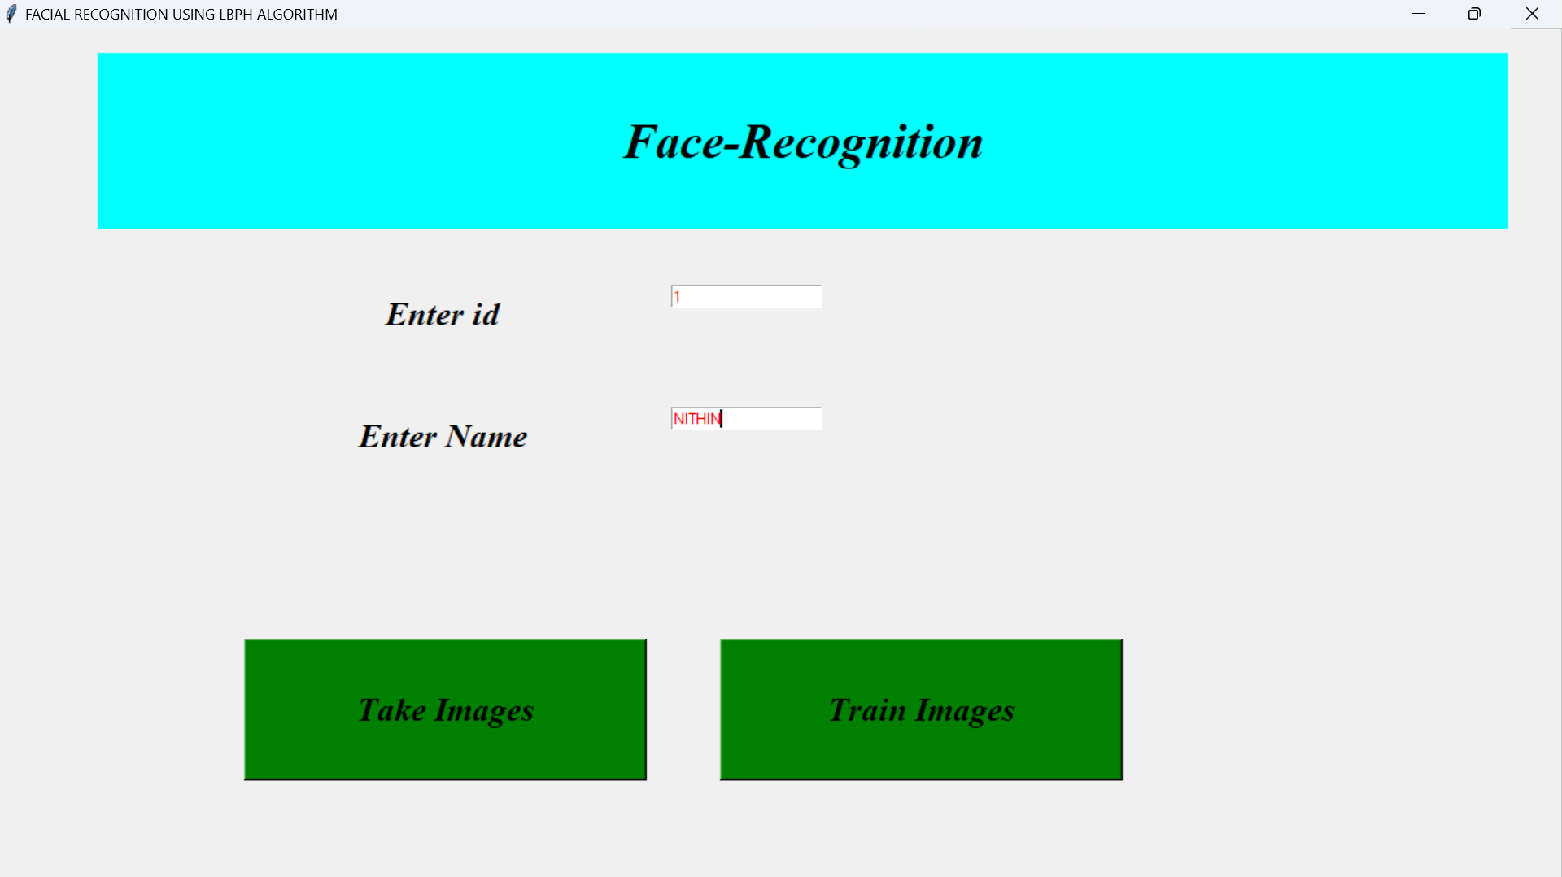
SIMULATION :-
Capturing images of a user:
Web Cam

Slide 20
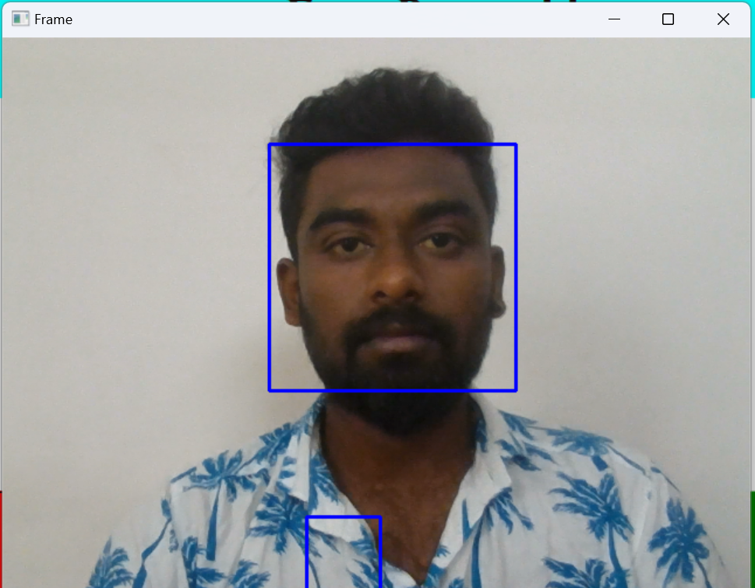

Slide 21
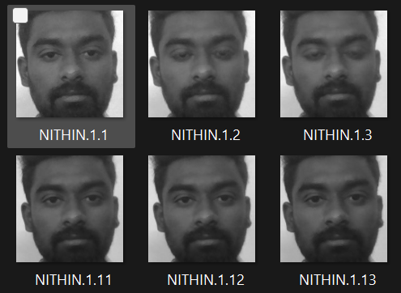
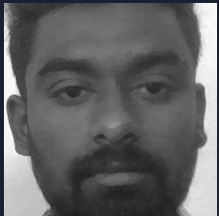
FEATURE EXTRACTION :-
Taken picture is converted into GRAY SCALE image
GRAY SCALE IMAGE
DATA SET

Slide 22
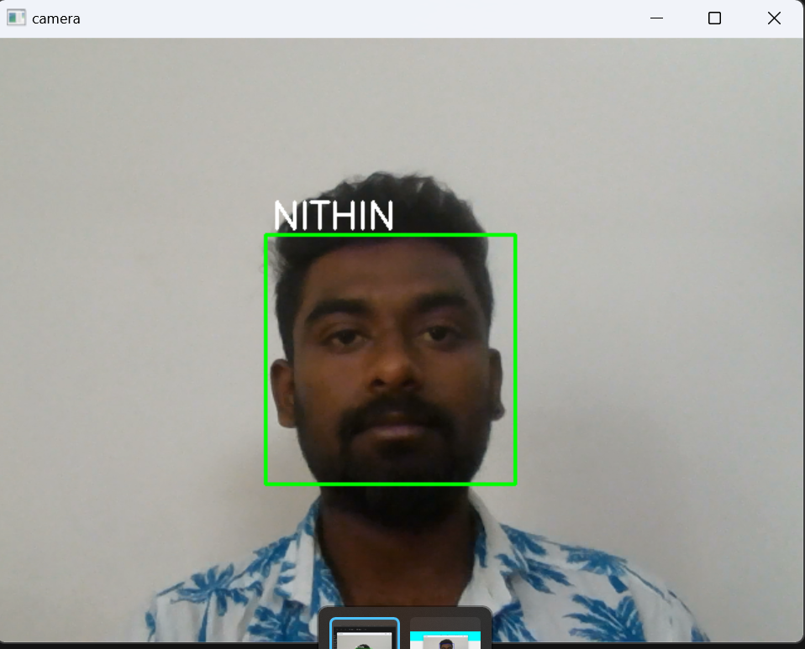
RECOGNITION :-
FACE RECOGNITION OF CAPTURED DATA

Slide 23
References
[1] B. Rajendran, A. K. Pandey and B. S. Bindhumadhava, "Secure and privacy preserving digital payment," 2017 IEEE SmartWorld, Ubiquitous Intelligence & Computing, Advanced & Trusted Computed, Scalable Computing & Communications, Cloud & Big Data Computing, Internet of People and Smart City Innovation (SmartWorld/SCALCOM/UIC/ATC/CBDCom/IOP/SCI), San Francisco, CA, 2017, pp. 1-5.
[2] https://qz.com/india/1746910/cashless-payments-growing-faster-in-india-than-almost-anywhere-else/
[3] Security of Mobile Payments and Digital Wallets, ENISA December 2016, https://www.enisa.europa.eu/publications/mobile-payments-security/at_download/fullReport.
[4] J. Ueda and K. Okajima, "Face morphing using average face for subtle expression recognition," 2019 11th International Symposium on Image and Signal Processing and Analysis (ISPA), Dubrovnik, Croatia, 2019, pp. 187-192. doi: 10.1109/ISPA.2019.8868931
[5] U. Park, Y. Tong and A. K. Jain, "Age-Invariant Face Recognition," in IEEE Transactions on Pattern Analysis and Machine Intelligence, vol. 32, no. 5, pp. 947-954, May 2010.
[6] E. Husni and A. Ariono, "Development of integrated mobile money system using Near Field Communication (NFC)," 2014 8th International Conference on Telecommunication Systems Services and Applications (TSSA), Kuta, 2014, pp. 1-6.

Slide 24
[7] Surekha. R. Gondkar, Saurab. B, C. S. Mala, “Biometric Face Recognition Payment System,“ 2018 International Journal of Engineering Research & Technology (IJERT), Volume 6, Issue 13, 2018, pp.1-6.
[8] S. Nair, S. K. Khatri and H. Gupta, "A Model to Enhance Security Of Digital Transaction," 2019 4th International Conference on Information Systems and Computer Networks (ISCON), Mathura, India, 2019, pp. 17-21.
[9] K. Patel, H. Han and A. K. Jain, "Secure Face Unlock: Spoof Detection on Smartphones," in IEEE Transactions on Information Forensics and Security, vol. 11, no. 10, pp. 2268-2283, Oct. 2016.
[10] A. Ahmed, J. Guo, F. Ali, F. Deeba and A. Ahmed, "LBPH based improved face recognition at low resolution," 2018 International Conference on Artificial Intelligence and Big Data (ICAIBD), Chengdu, 2018, pp. 144-147
[11] X. Zhang, K. Jing, Y. Dai and X. Xu, "Face Biometric Identity Authentication System," 2018 IEEE 4th International Conference on Computer and Communications (ICCC), Chengdu, China, 2018, pp. 1473-1477

Slide 25


